Slide 1
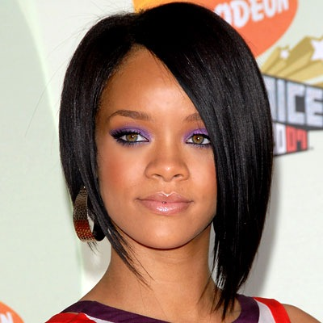
Rihanna

Slide 2
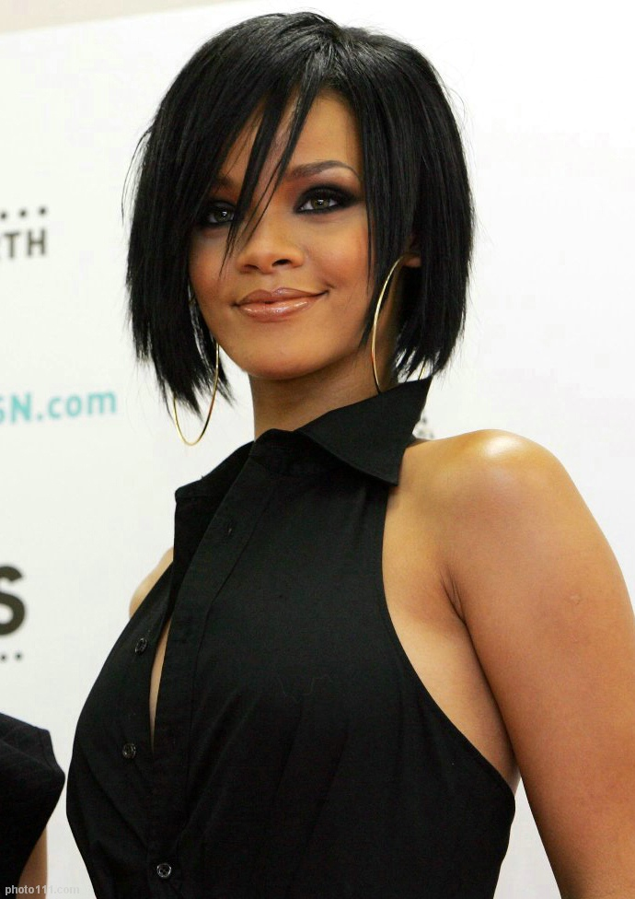
Biography
Full name Robyn Rihanna Fenty, born February 20, 1988. The well-known singer born in Saint Michael, Barbados, began her career in 2003.

Slide 3
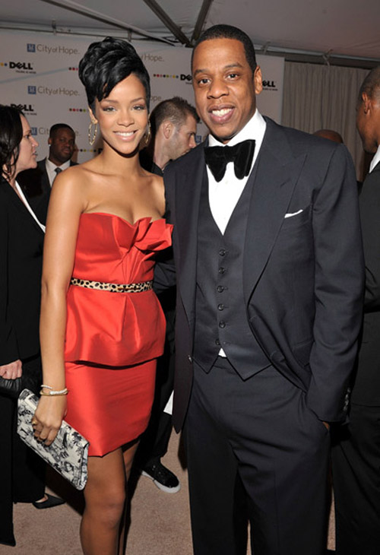
In 2004 at age 16, she moved to the United States to start a recording career and began recording demo tapes under Rogers' guidance.

Slide 4
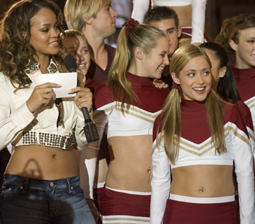
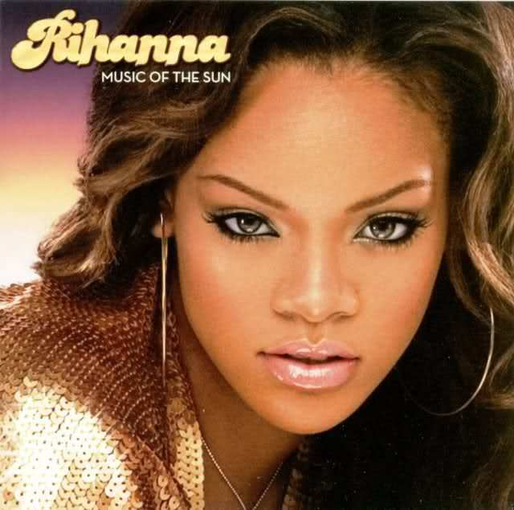
In 2005, Rihanna made a tour with Gwen Stefani and starred in his first film, «Bring It On All or Nothing». in the same year released her debut album Music of the Sun (2005)

Slide 5

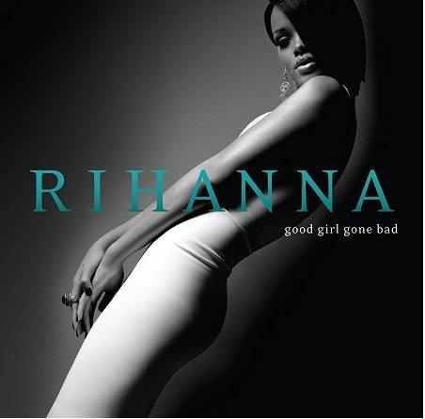
Second album "A Girl Like Me" was released in April 2006.

Slide 6
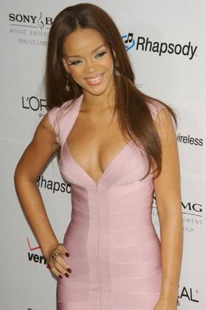
The songs "Shut Up and Drive", "Hate That I Love You" and "Don't Stop The Music" were also released as singles from the album. In support of the album, she kicked off her second headlining tour, the Good Girl Gone Bad Tour in September 2007, with a total of 80 shows across the US, Canada and Europe.

Slide 7
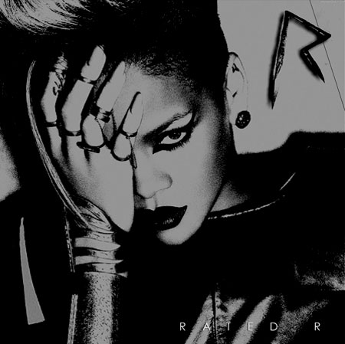
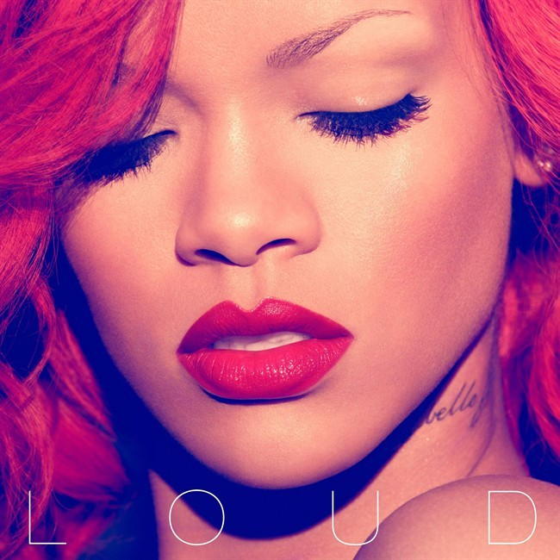
Her fourth album, “Rated R”, was released in November 2009. In 2010 release fifth studio album entitled “Loud”

Slide 8

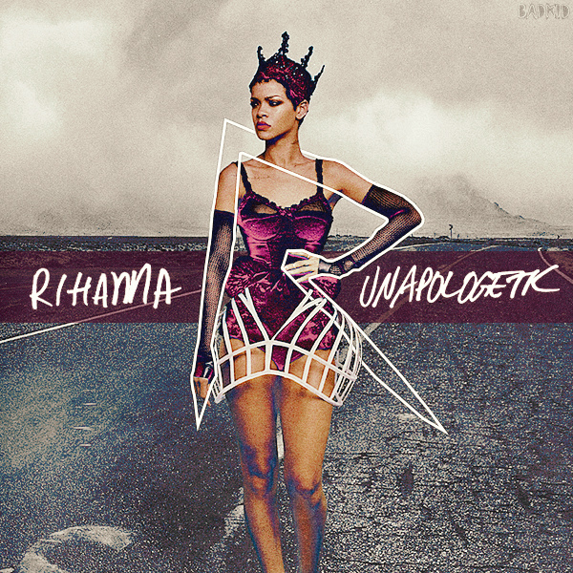
Rihanna's sixth album, "Talk That Talk", was released in November 2011.
Seventh studio album, "Unapologetic", was released on November 19, 2012.

Slide 9
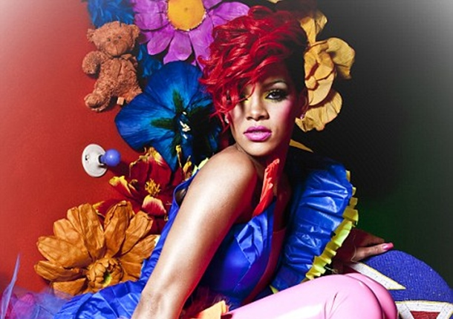
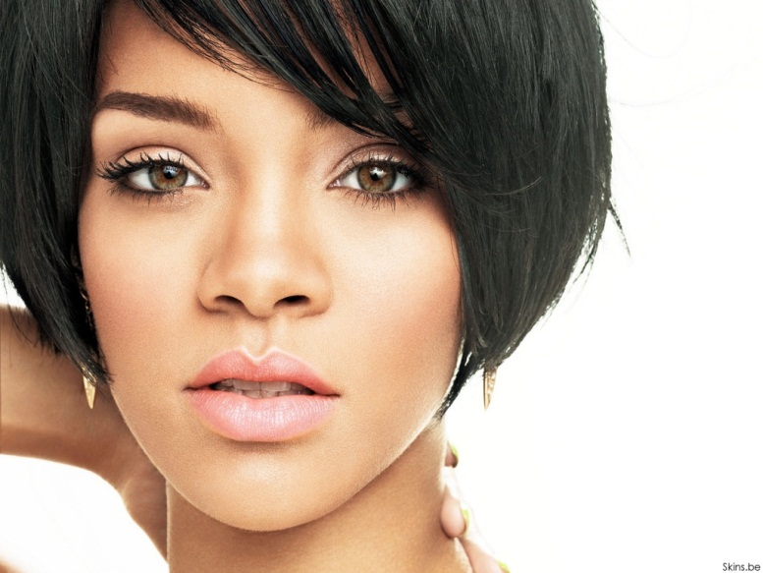
Why I chose this famous person? Because she has good songs and she is a bright personality. Rihanna is an example for imitation, in its 25 years has released 7 albums, often toured the world and continues to actively develop your career. Information about this singer can be obtained from the Internet, from magazines, Newspapers and
television.

Slide 10


