Slide 1
Unit 4. Seasons and Nature
Lesson 2
Seasons of the year
Form 2

Slide 2
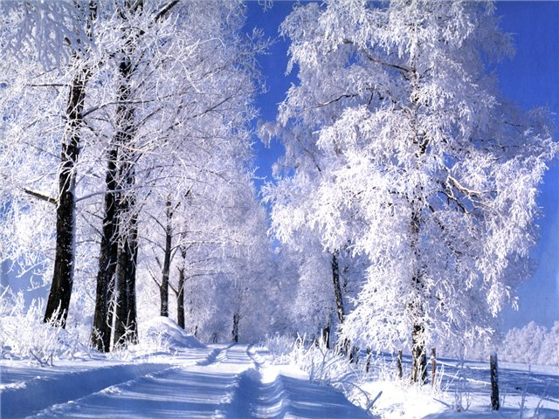
Winter months
December
February
January

Slide 3

Spring months
May
March
April

Slide 4

Summer months
August
June
July

Slide 5
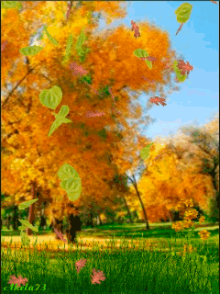
Autumn months
September
November
October

Slide 6
What are winter months?
February
January
September
December

Slide 7
What are spring months?
June
May
April
March

Slide 8
What are summer months?
October
July
June
August

Slide 9
What are autumn months?
September
December
October
November

Slide 10
What month is it?
a
y
m

Slide 11
What month is it?
u
j
y
l

Slide 12
What month is it?
p
a
l
i
r

Slide 13
Reading
True or false?
Dan’s favourite season is winter.
It is cold and rainy in winter.
Dan can play football in winter.
Dan can ski in winter.

Slide 14

Well done!

