Slide 1
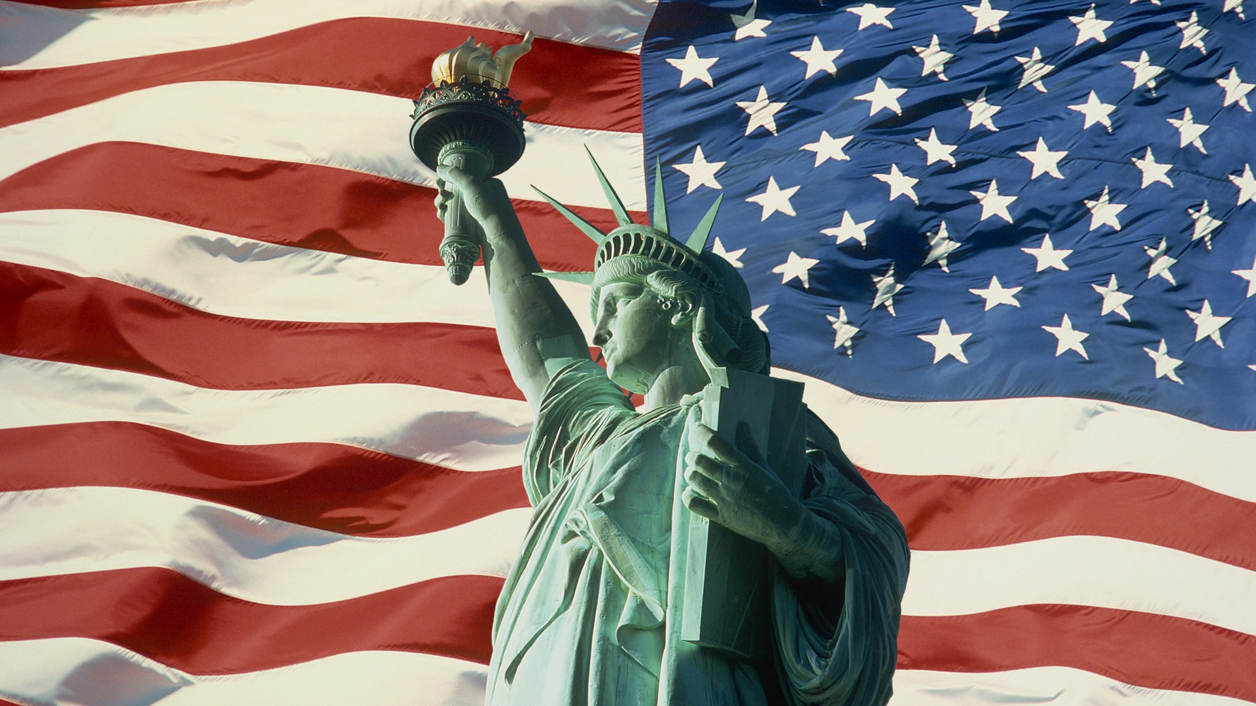
The USA

Slide 2
Topic:
The large cities of the USA

Slide 3
Our Aims:
to speak about large cities in the USA
to listen and understand the information and songs
to read short texts

Slide 4
 | I am | Teacher
Speaking
Writing
Reading
Listening
Total

Slide 5
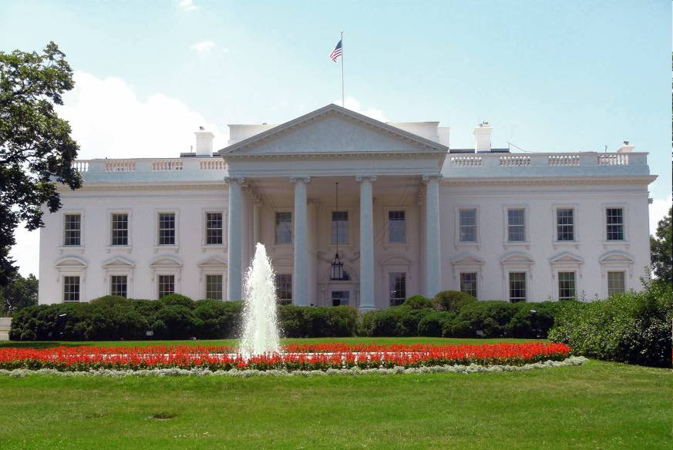
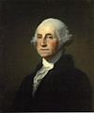
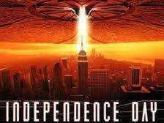
The USA Quiz.
1.Where does the President of the United States live and work?
a) In Congress.
b) In the White House.
c) In the Pentagon.
b) In the White House.
2. Who was the first president of the USA?
a) George Washington.
b) Abraham Lincoln.
c) Ulysses Grant.
a) George Washington.
3. Why do the Americans celebrate the 4th of July?
a) The first moon landing.
b) Declaration of Independence.
c) The end of the America Civil War.
b) Declaration of Independence.

Slide 6
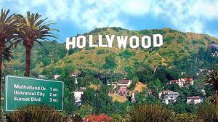
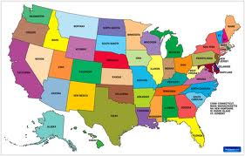
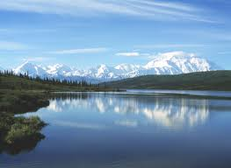
4. In which city is Hollywood?
a) New York.
b) San Francisco.
c) Los Angeles.
c) Los Angeles.
5. How many states are there in the USA?
a) 48
b) 52
c) 50
c) 50
6. Which is the biggest state in the USA?
a) Texas.
b) California.
c) Alaska.
c) Alaska.

Slide 7
Alaska

Slide 8
Words for listening:
wilderness — wild uncultivated waste land;
inlet — strip of water extending into the land from a larger body of water (the sea, a lake) or between islands;
glaciers — mass of ice, formed by snow on mountains, moving slowly along a valley;
canyon — deep gorge (usually with a river flowing through it);
salmon — large fish, valued for food;
halibut — large, flat sea-fish used as food;
barley — grass-like plant, seeds used for food and for making beer;
hardy crops — plants able to endure frost without being injured.

Slide 9
The second level. True or false.
1.The name Alaska comes from a word used by foreign people.
2. Alaska is situated near the Texas state.
3. Alaska is one of the most famous state, because it reaches the wilderness.
4. In Alaska lives polar bears, grizzly bears, wolf, elephants, deer and mountain goats.
5. The waters off Alaska’s shores are rich in salmon, herring, halibut and crab.
6. Crops grow rapidly, because the summer sun shines 20 hours a day.

Slide 10
The third level. Finish the sentences.
1.The name Alaska comes from _____________________________________________________________
2.Alaska is by far the largest _____________________________________________________________
3.Alaska has almost all active volcanoes in the United States, as well as _____________________________
4.Huge forests cover about _____________________________________________________________
5.Wild animals include polar bears, grizzly bears, _______________________________________________
6.Crops grow rapidly because the summer ____________________________________________________

Slide 11
The fourth level.
Choose and tell key-facts about Alaska.

Slide 12
Alaska

Slide 13
The second level. True or false.
1.The name Alaska comes from a word used by foreign people. ─
2. Alaska is situated near the Texas state. ─
3. Alaska is one of the most famous state, because it reaches the wilderness. +
4. In Alaska lives polar bears, grizzly bears, wolf, elephants, deer and mountain goats. ─
5. The waters off Alaska’s shores are rich in salmon, herring, halibut and crab. ─
6. Crops grow rapidly, because the summer sun shines 20 hours a day. +

Slide 14
The third level. Finish the sentences.
1.The name Alaska comes from a word used by native
people meaning great land or main-land
2.Alaska is by far the largest state in the United States
3.Alaska has almost all active volcanoes in the United
States, as well as the16 highest peaks in the country.
4.Huge forests cover about a third of the state.
5.Wild animals include polar bears, grizzly bears, deer and
mountain goats
6.Crops grow rapidly because the summer sun shines 20
hours a day.

Slide 15
Alaska

Slide 16
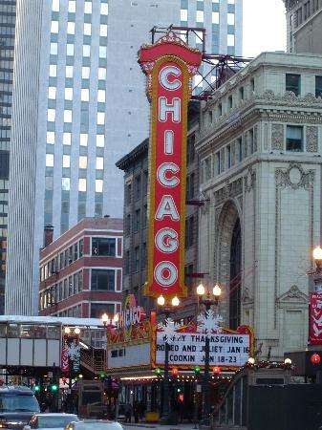
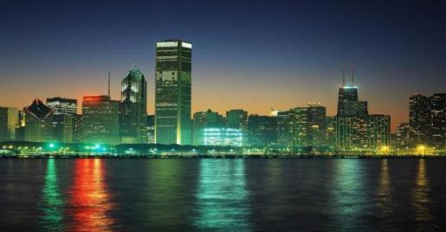
Chicago

Slide 17
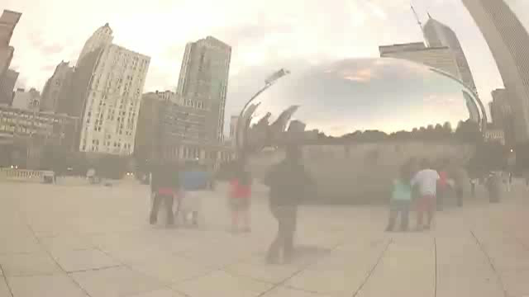

Slide 18
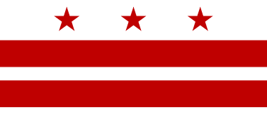
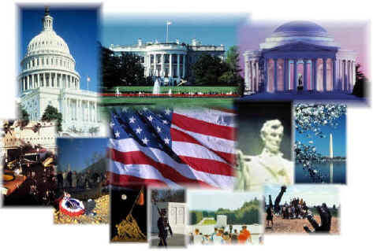

Washington D.C.

Slide 19
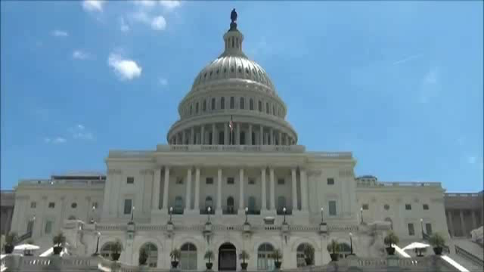

Slide 20
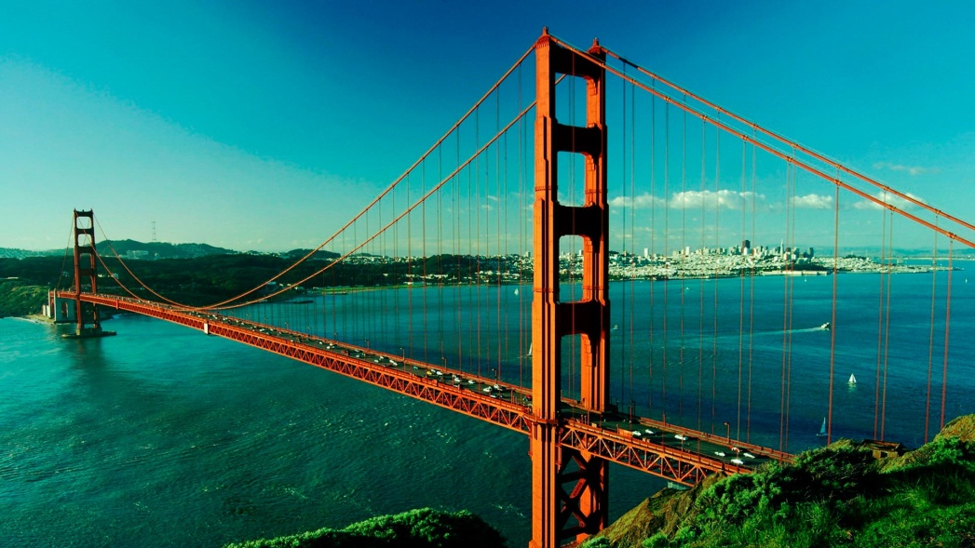
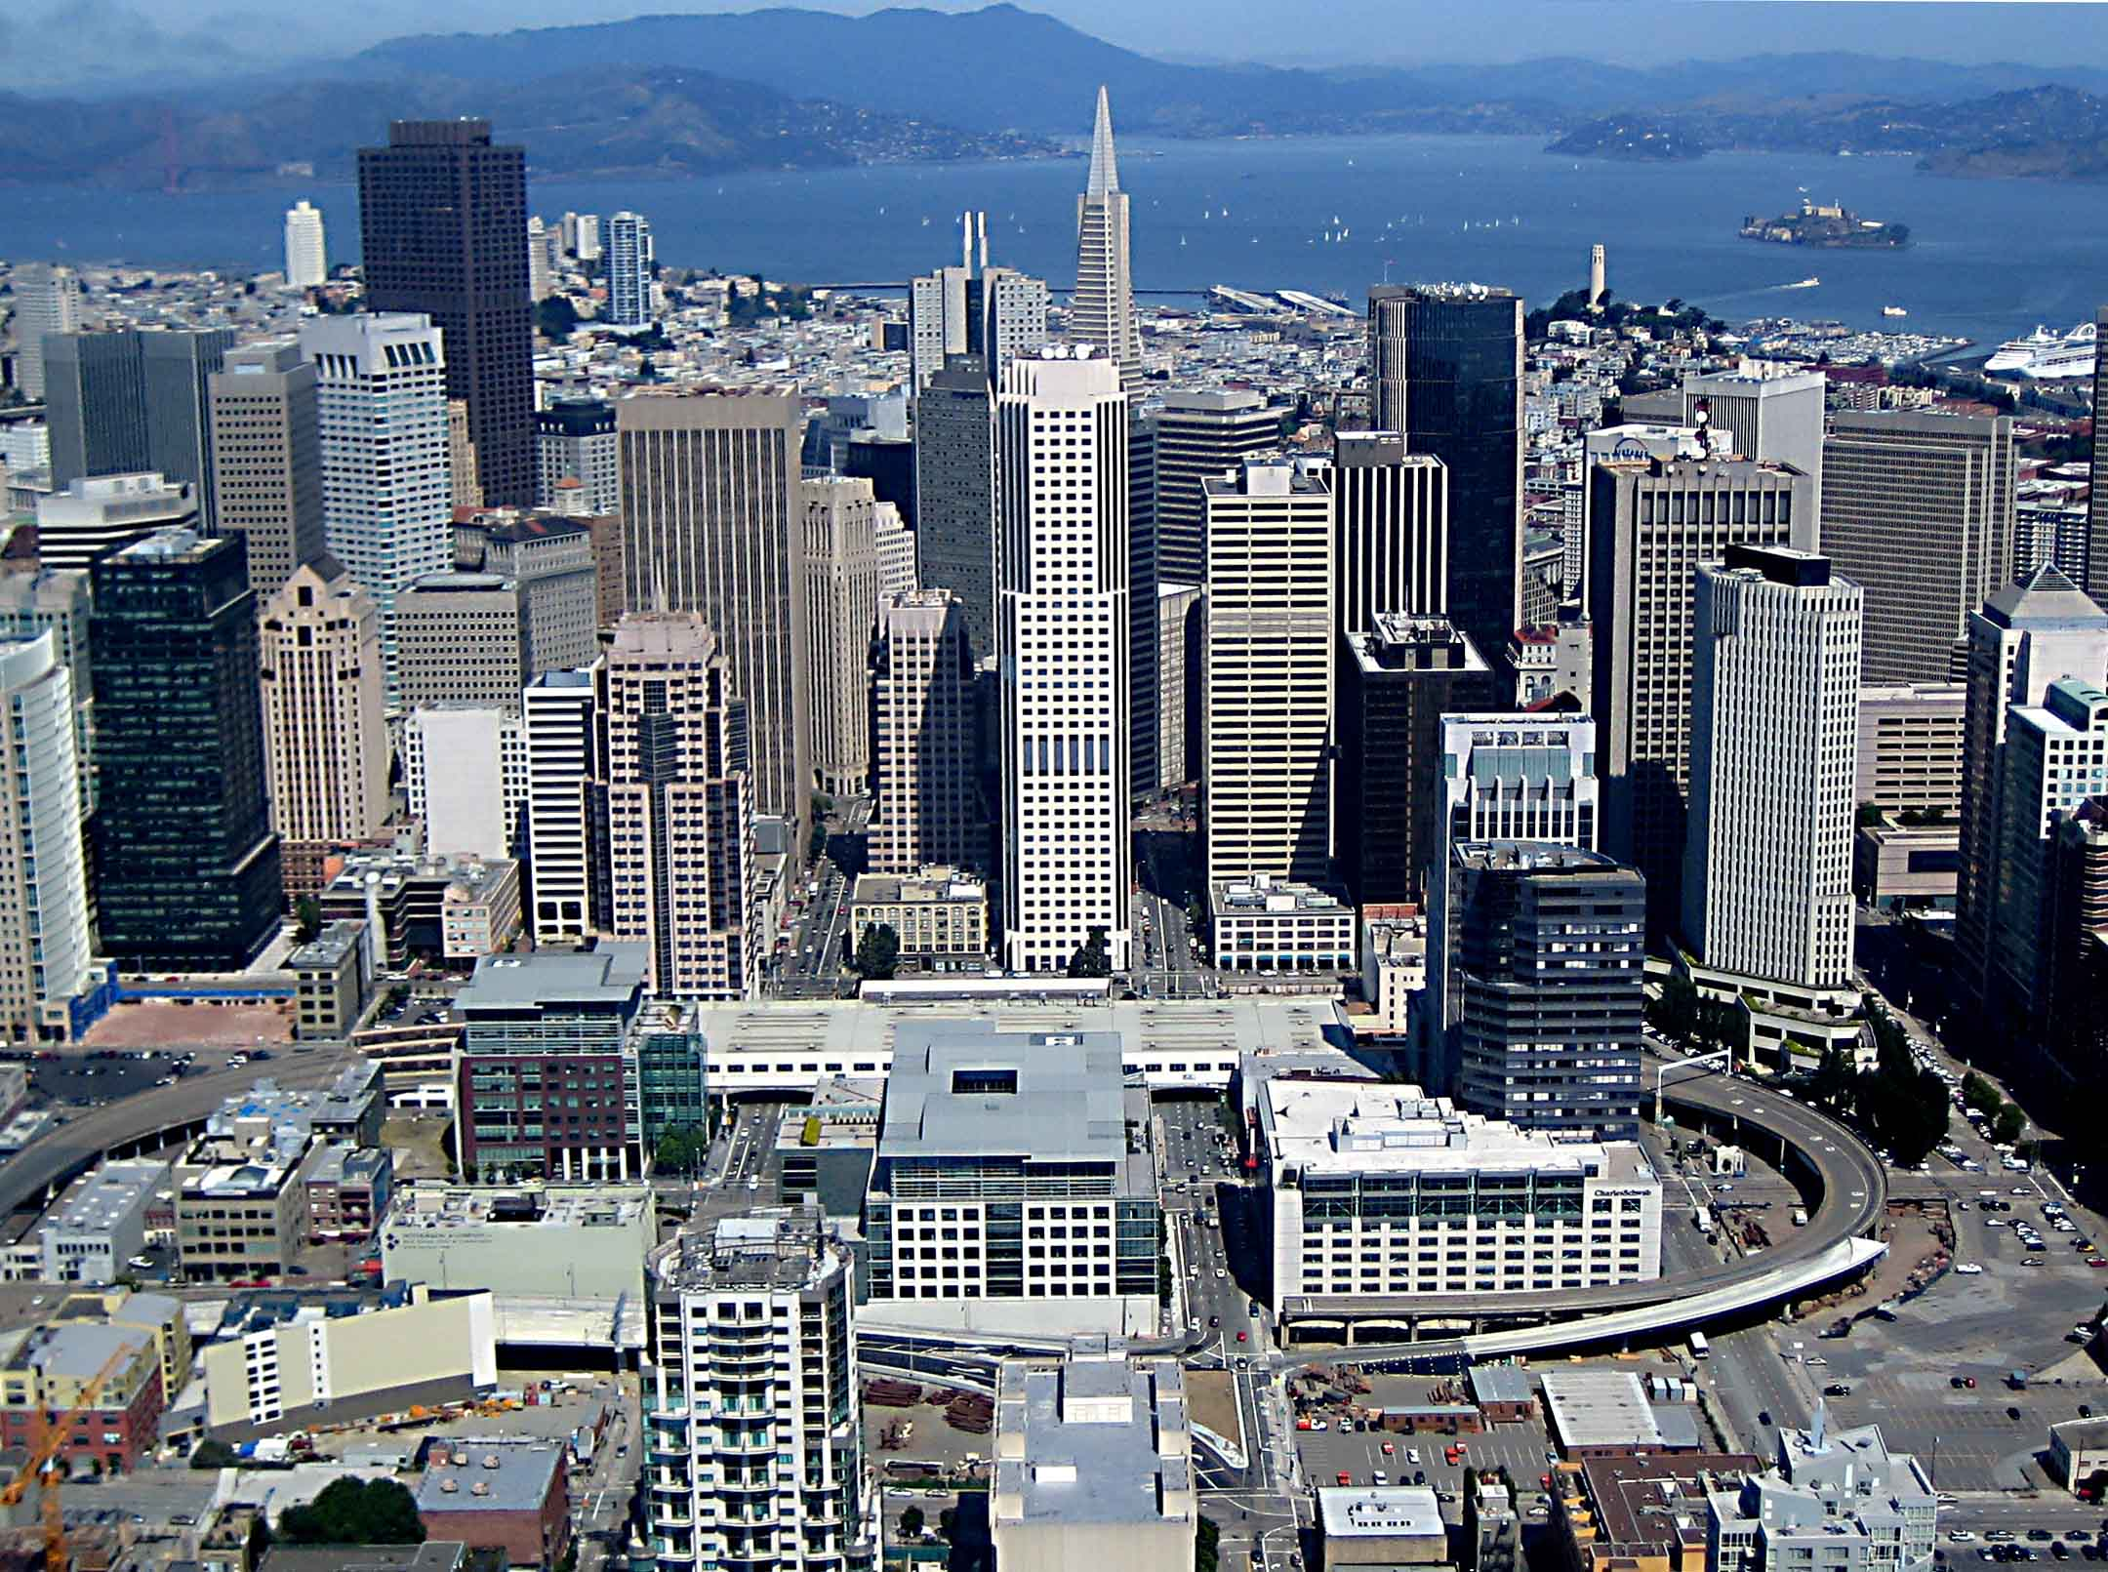
San Francisco

Slide 21
Hometask
On the second level you have to read the names of
the states, look at the grid and try to find all the states.
On the third level you have to make Mind-Map
about one of the American state.(Key-facts).
On the fourth level you have to make up
a booklet about the sightseeing of America.

Slide 22

Well done!

