Slide 1
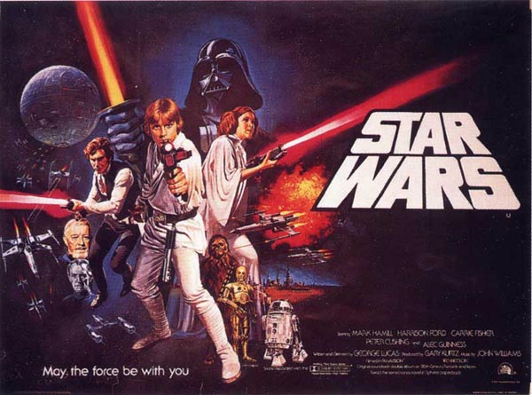
Science fiction film

Slide 2

War
film

Slide 3
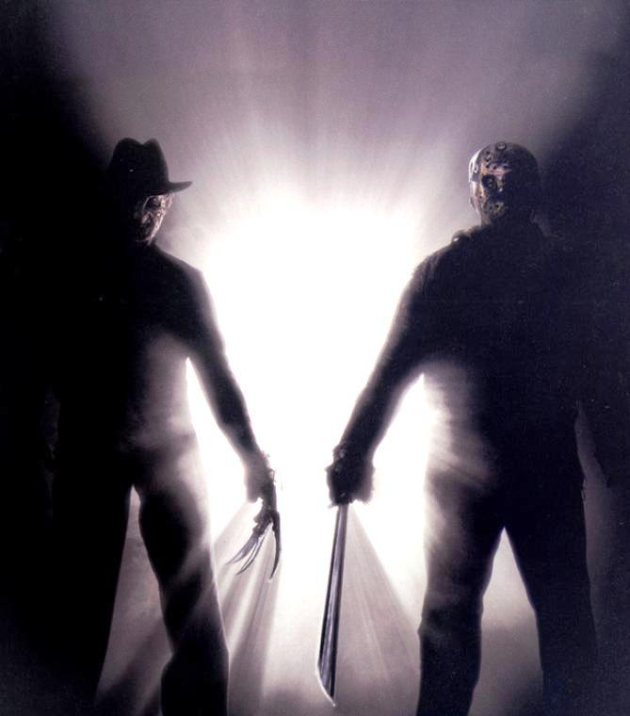
Horror film

Slide 4
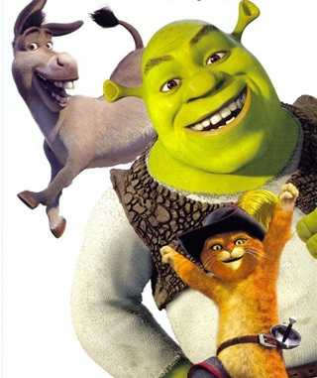
Animated
cartoon

Slide 5
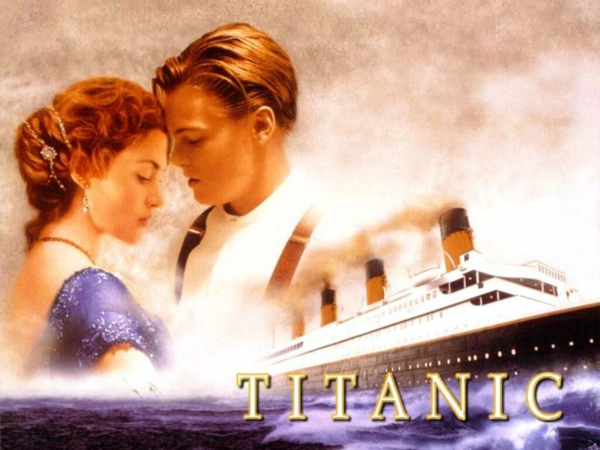
Historical
melodrama

Slide 6
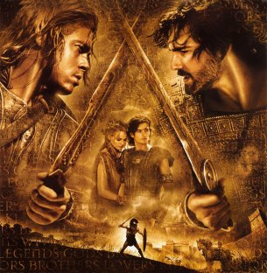
Historical film

Slide 7
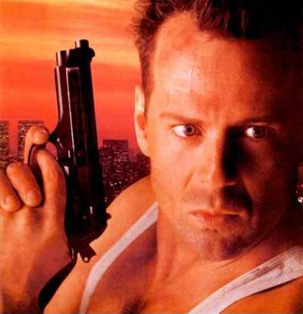
Action

Slide 8
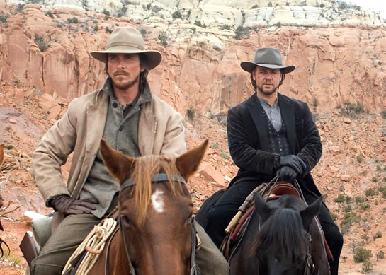
Western

Slide 9
What Types of
Films :
- do you enjoy watching?
don’t you mind watching?
can’t you stand watching?

Slide 10
WHAT DO YOU KNOW ABOUT FILM MAKING INDUSTRY?
Short part of a film
2) The words and directions that are written for the film
3) A prize
4) People who direct the making of films
5) A film that tells a fictional story
6) All the companies and studios that make a film
7) Films that give true information
(scenes)
(screenplay)
(award)
(directors)
(drama)
(film industry)
(documentaries)

Slide 11
A FILM REVIEW
INTRODUCTION (name, type, actors)
THE STORY (what happens?)
OTHER ASPECTS OF THE FILM (acting, music, special effects)
YOUR OPINION (why you liked/ did not like it)

Slide 12
WORK IN GROUPS, MAKE A PROJECT
TYPES OF FILMS
FILM MAKING INDUSTRY
FILM REVIEW
GROUP 1
GROUP 2
GROUP 3

Slide 13
Thanks for your work!

