Slide 1
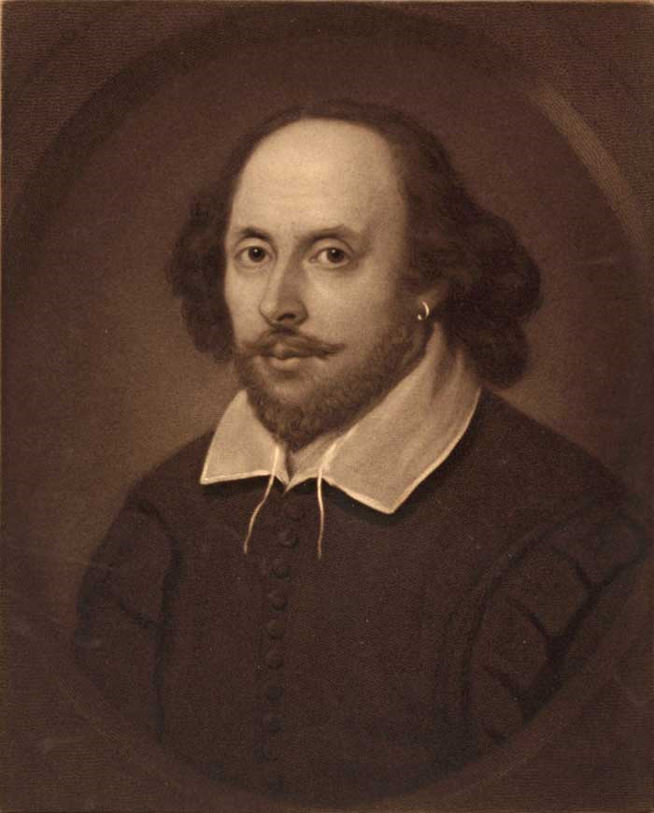
William Shakespeare
(1564-1616)
“ He was not of an age
but for all time”.
Ben Jonson,
an English dramatist

Slide 2
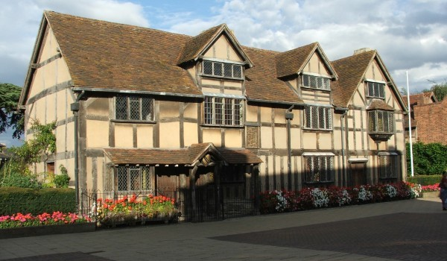
Shakespeare’s birthplace,
Stratford-upon-Avon

Slide 3
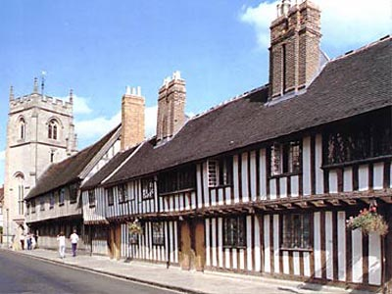
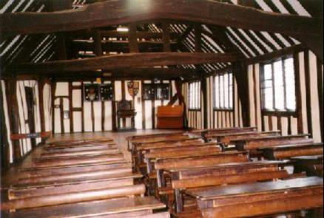
Shakespeare went to grammar school

Slide 4
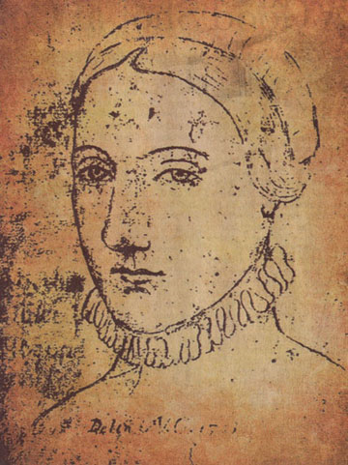
Anne Hathaway, Shakespeare’ s wife

Slide 5
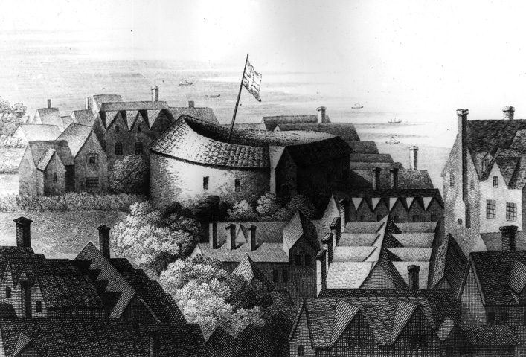
The Original Globe Theatre

Slide 6
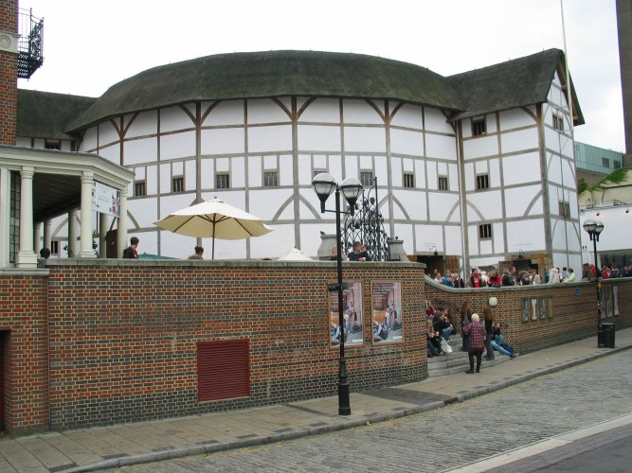
Shakespeare’s Globe Theatre

Slide 7
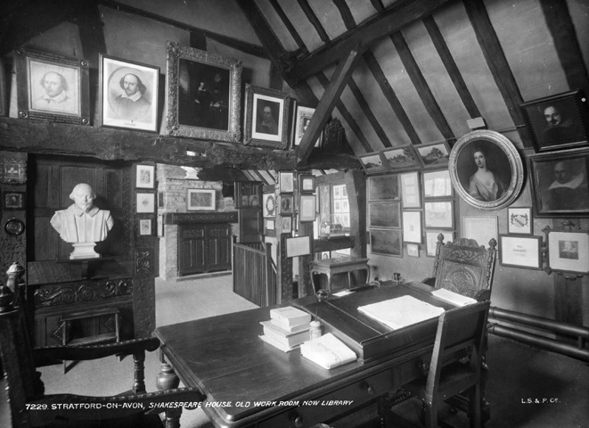
Shakespeare's work room
Shakespeare's house, New Place, in Stratford-upon-Avon

Slide 8
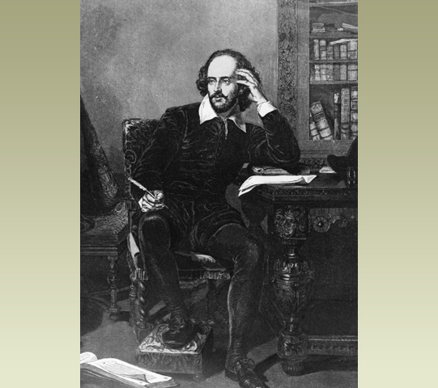
A portrait of Shakespeare at his desk

Slide 9
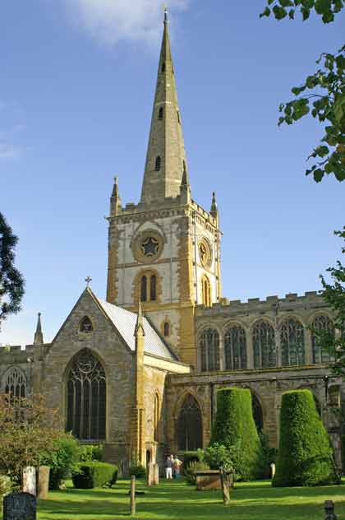
The Holy Trinity Church
where Shakespeare was buried

Slide 10
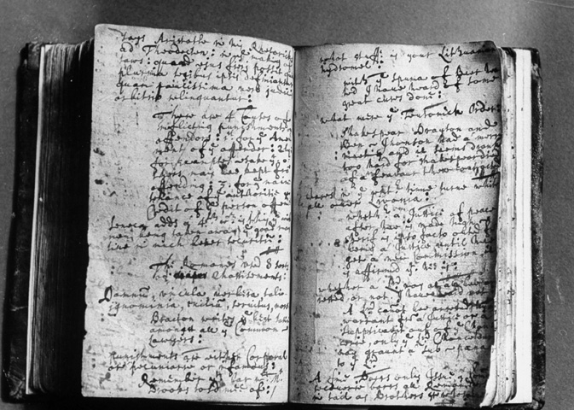
An original manuscript

Slide 11
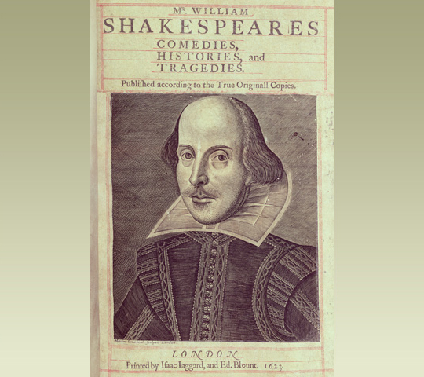
The title page of the first complete edition of Shakespeare's plays. Shakespeare didn't publish his plays during his lifetime. The first collection of his work was produced by his friends after his death.

Slide 12
Comedies
“The Comedy of Errors” – Комедія помилок
”All’s Well that Ends Well” –
Все добре, що добре закінчується
”A Midsummer Night’s Dream” – Сон літньої ночі
”Much Ado about Nothing” – Багато галасу даремно
”Twelfth Night” – Дванадцята ніч

Slide 13
Tragedies
”Hamlet” – Гамлет
”Othello” – Отелло
”King Lear” – Король Лір
”Macbeth” – Макбет
”Romeo and Juliet” – Ромео і Джульєта
”Julius Caesar” – Юлій Цезарь

Slide 14
History plays
“Henry VI “ - Генріх VI
“Richard III - Річард III

Slide 15
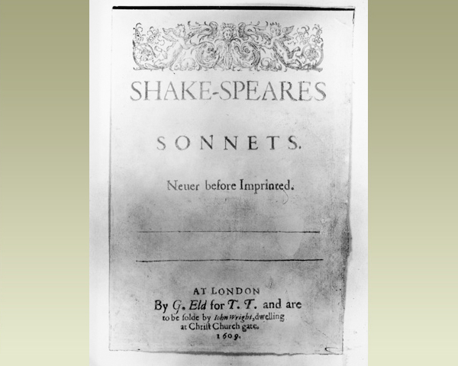
The cover of the first edition of William Shakespeare's 'Sonnets', dated 1609

Slide 16
Sonnet 25
Let those who are in favour with their stars
Of public honour and proud titles boast,
Whilst I, whom fortune of such triumph bars,
Unlook'd for joy in that I honour most.
Great princes' favourites their fair leaves spread
But as the marigold at the sun's eye,
And in themselves their pride lies buried,
For at a frown they in their glory die.
The painful warrior famoused for fight,
After a thousand victories once foil'd,
Is from the book of honour razed quite,
And all the rest forgot for which he toil'd:
Then happy I, that love and am beloved
Where I may not remove nor be removed.

Slide 17
Sonnet 116
Let me not to the marriage of true minds
Admit impediments. Love is not love
Which alters when it alteration finds,
Or bends with the remover to remove:
O no! it is an ever-fixed mark
That looks on tempests and is never shaken;
It is the star to every wandering bark,
Whose worth's unknown, although his height be taken.
Love's not Time's fool, though rosy lips and cheeks
Within his bending sickle's compass come:
Love alters not with his brief hours and weeks,
But bears it out even to the edge of doom.
If this be error and upon me proved,
I never writ, nor no man ever loved.

Slide 18
Sonnet 130
My mistress' eyes are nothing like the sun;
Coral is far more red than her lips' red;
If snow be white, why then her breasts are dun;
If hairs be wires, black wires grow on her head.
I have seen roses damask'd, red and white,
But no such roses see I in her cheeks;
And in some perfumes is there more delight
Than in the breath that from my mistress reeks.
I love to hear her speak, yet well I know
That music hath a far more pleasing sound;
I grant I never saw a goddess go;
My mistress, when she walks, treads on the ground:
And yet, by heaven, I think my love as rare
As any she belied with false compare.

Slide 19
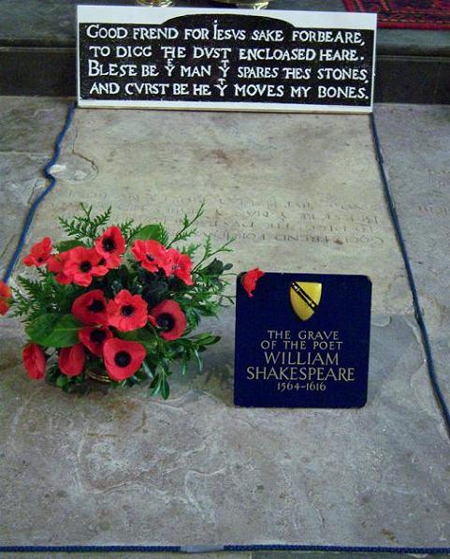
The Grave of the poet

Slide 20


