Slide 1

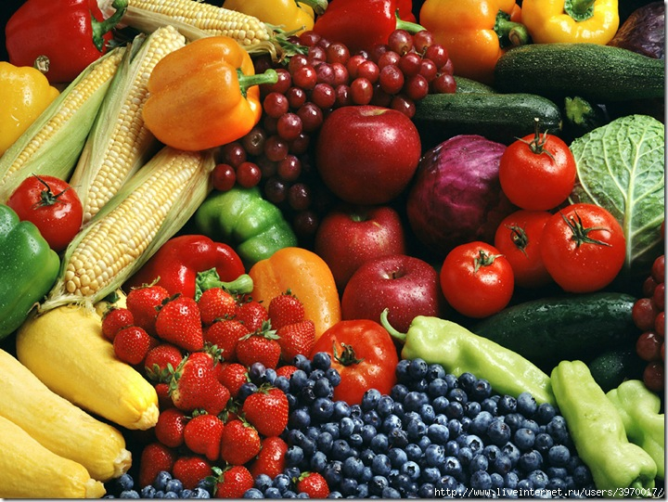
HEALTHY and UNHEALTHY FOOD
[æ] ham, jam, apple…
[i:] tea, cheese, eat, meat…
[e] vegetable, egg, breakfast…
[o] coffee, porridge, orange…

Slide 2
for keeping energy
for pleasure
People eat
to live
from force of habit

Slide 3
•Tastes differ. •An apple a day keeps the doctor away. •The appetite comes with eating. •Every vegetable has its season. •After dinner sit a while, after supper walk a mile. •Too much butter won’t spoil the porridge. Breakfast like a king, lunch like a queen and dinner like a pauper. | Сніданок з’їж сам , обід розділи з другом, вечерю віддай ворогові •Апетит приходить під час їжі. •Кашу маслом не зіпсуєш. •Про смаки не сперечаються. •Кожен день з’їж яблуко, забудеш про лікарів. •Після обіду трохи посидь, після вечері з милю пройдись. •Кожен овоч має свою пору року.

Slide 4
Find the odd word.
1.milk –cake –juice –tea
3. carrots –cabbage –tomatoes –fish
2. apples –oranges –potatoes –bananas
4. sweets –ice-cream –chocolate –meat
5. cheese- yogurt – onion- milk
6. garlic – carrot – strawberry

Slide 5
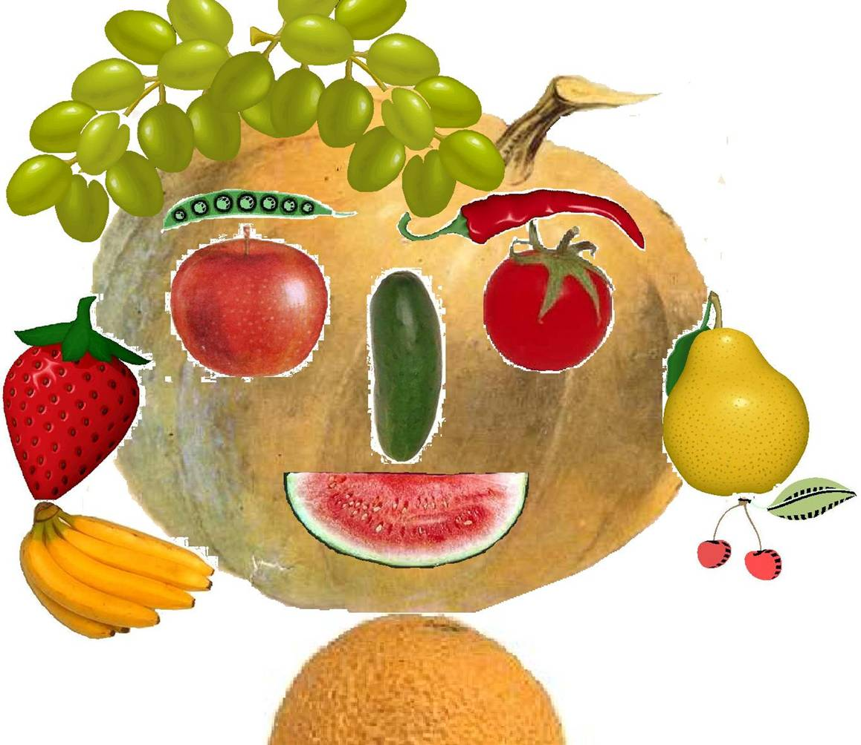

Slide 6
Correct the mistakes.
I’d like any water, please.
Are there much pupils in the class?
Is there some cheese in the fridge?
Give me any sweets, please.
He has many money.
There aren’t some pictures in the book.
I have got much friends

Slide 7
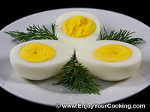

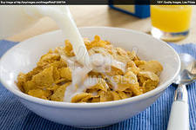
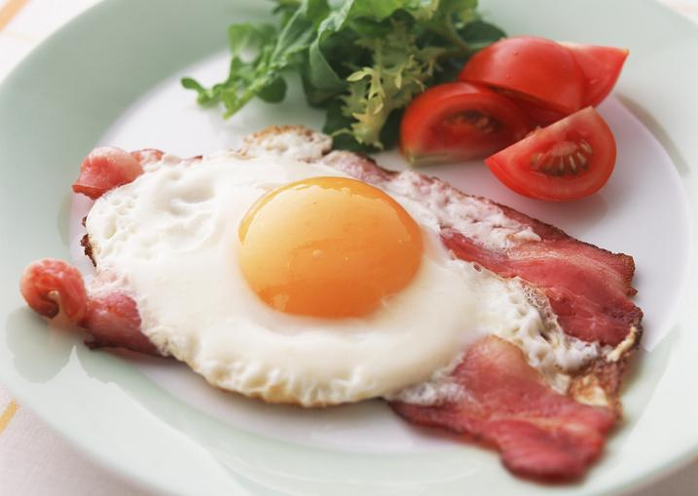

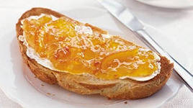

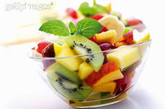


Slide 8
1. All food is good for you.
2. Vitamins and minerals help you to keep healthy.
3.Fruit and vegetables are full of sugar and fat.
4. Sweets, chips and coke keep you healthy.
5. You should eat a variety of foods to stay healthy and grow big and strong.

Slide 9

Words
Сhicken , rice, eat, a bowl of soup, bread, a glass of juice,fish, salad, potato, a cup of tea, sweets,a bottle of cola, cake, biscuits, hamburgers, ice- cream, sweets.

Slide 10



If you are fond of Ukrainian cuisine,
come to our “School Canteen”.
The service is good!
You can find Ukrainian dishes
from all the regions of our country.
We are opened from 8 am till 3 pm
  Our address is 88, Rostovska Street.

