Slide 1
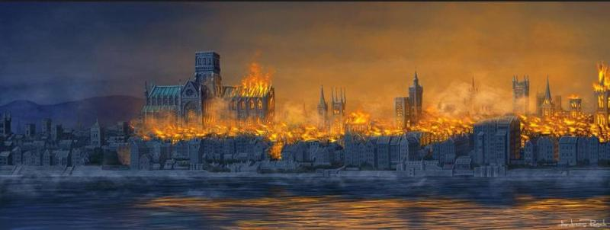
Great Fire of London

Slide 2
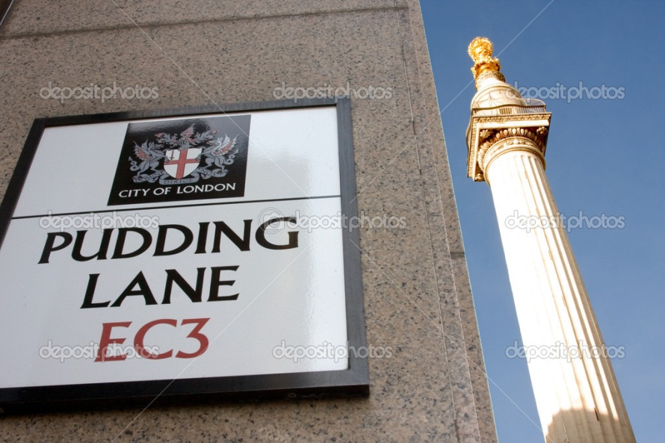
Beginning
Great Fire of London - naming fire, seized central London.
The fire started in the house of a baker on Pudding Lane on Sunday 2nd September 1666 and was completed on Wednesday, September 5 after the destruction of 80% of the buildings in the City

Slide 3
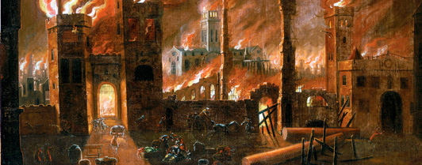
Losses
The fire burned 13,500 houses, 87 churches (even St. Paul's Cathedral), most of the government buildings. It is believed that the fire was deprived of shelter 70 thousand people, with the then population of central London in 80 thousand.

Slide 4
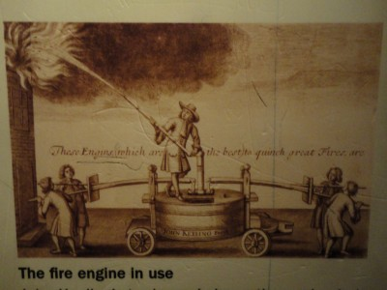
How extinguished and who burned
Firefighters at the time, as a rule, used the method of destruction of buildings around the fire so that the fire did not spread. This is not done just because the Lord Mayor, Mr. Thomas Bladvort, was not sure of the need for such measures. By the time he ordered the destruction of the building, it was too late.

Slide 5
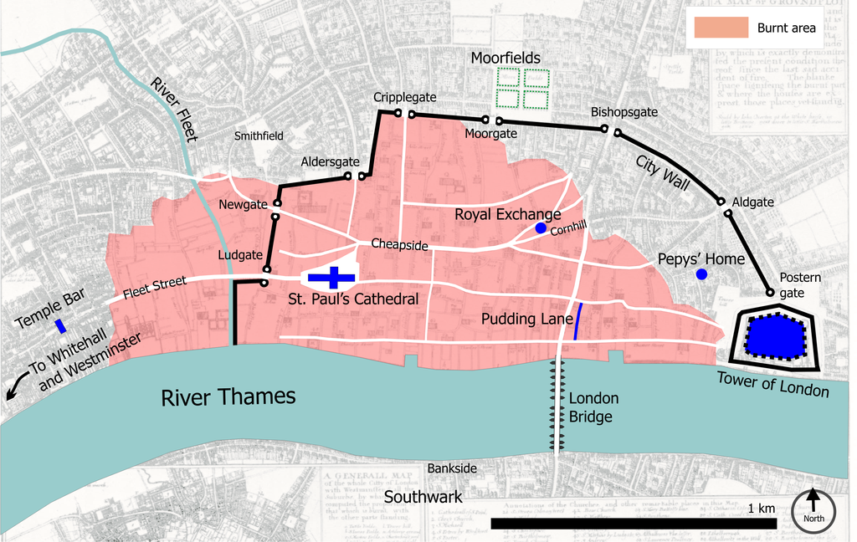
Spread of the fire

Slide 6
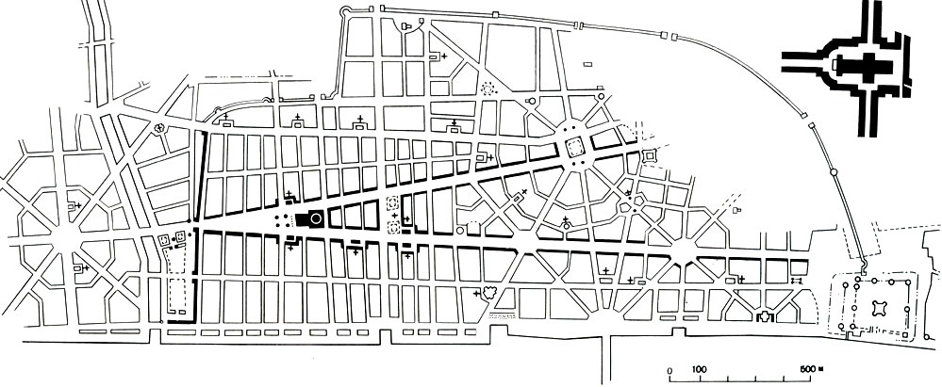
Rebuilding
Medieval slums were completely burned. This has helped London to begin to develop as a modern city. Now the main task of government was to re-plan the city and restore it. It was commissioned Christopher Wren.

Slide 7
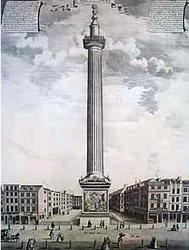
Monument fire
As a symbol of recovery City, it was decided to erect a monument to the great fire near the place where it started. Sir Christopher Wren, the royal inspector and architect of the Cathedral of St.. Paul and his friend and colleague, Dr. Robert Hooke, a project created for the colossal monument in the form of a Doric column.

Slide 8
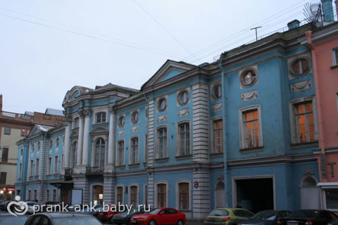
Once there was a fire .

Slide 9
Thank you for attention)
Internet resources:
http://townevolution.ru/books/item/f00/s00/z0000016/st039.shtml
http://ru.depositphotos.com/2018141/stock-photo-pudding-lane-and-monument-london.html
http://www.studing.od.ua/dostoprimechatelnost-londona-monument-pamyatnik-velikomu-londonskomu-pozharu/
http://www.baby.ru/blogs/post/315969112-287583249/

